Slide 1
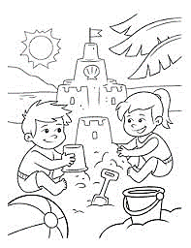
Colour:
Colour:

Slide 2
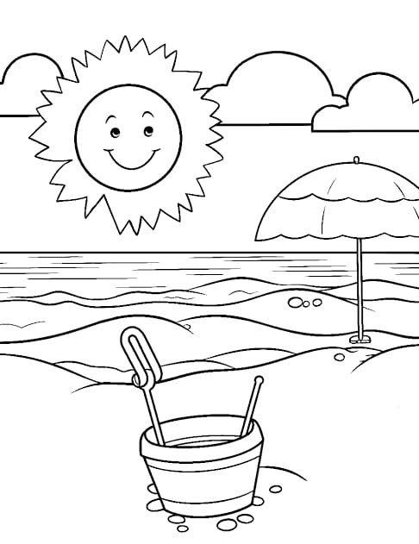
Colour:
Colour:

Slide 3
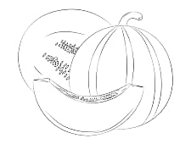
Colour:
Colour:

Slide 4
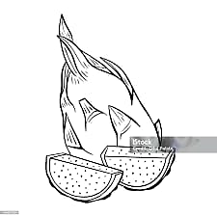
Colour:
Colour:

